Slide 1
Bootcamp 2020
Session 01: Docker and Docker Compose

Slide 2
Welcome
This course aims to provide you with knowledge and practical skills necessary to create containerized applications and deploy them in production environments like Kubernetes.
5 sessions:
Session 1 - Introduction to Docker and Docker Compose
Session 2 - Creating Docker Images, Good Dockerfile Practices and Bash Containers
Session 3 - Introduction to Kubernetes
Session 4 - Basic Kubernetes
Session 5 - Final Project

Slide 3
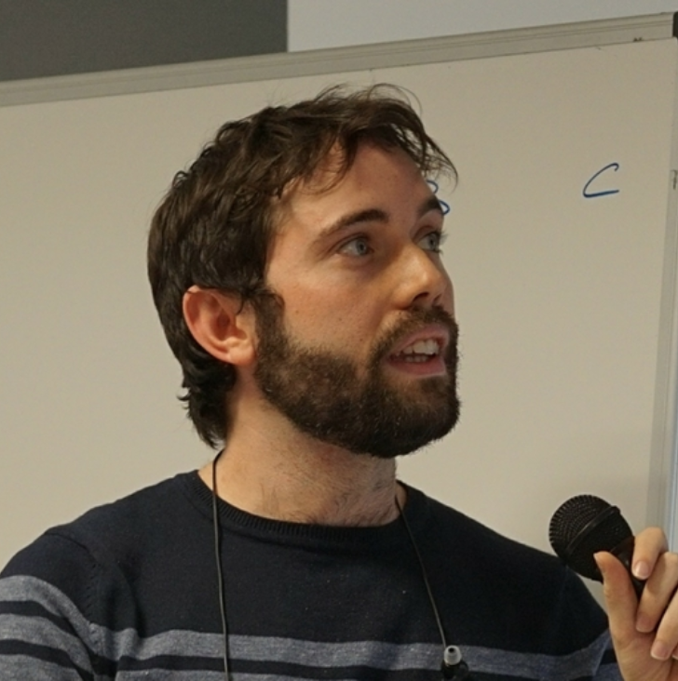




The lecturers
Javier J. Salmerón
Juan Ariza Toledano
Juan José (Jota) Martos
Tomás Pizarro
Alejandro Moreno
Course coordinator

Slide 4
Welcome
The spoken language of the workshop is Spanish but all documents and exercises will be in English.
Please provide proactive feedback on whether you are understanding what we are teaching.
All documents, exercises and references will be available in OneDrive or GitHub.

Slide 5
Welcome
Although theory is necessary, the goal is you learn by doing. We will give you access for launching instances in the Cloud if necessary.
This is NOT a competition. You should help each -other to understand the concepts.

Slide 6
Welcome
The team is doing a big effort for this course: sponsorship, materials, time, etc.
What do we expect from you?
Read in advance all the references that we will give you so sessions will be more productive for all of us.
Send exercises on time and check the comments and suggestions from us to improve them.
Punctuality.

Slide 7
Intro: The Journey to Containers
Setting up our environment: recap of Git
Lunch
Introduction to Docker
Introduction to Docker Compose

Slide 8
Intro: The Journey to Containers

Slide 9
You have to know to the past to understand the present”
Carl Sagan

Slide 10
What do we usually need to deploy an application?
Application Code
Database
Runtime
Web Server
Operating System
Hardware
What do we want? Automation!

Slide 11

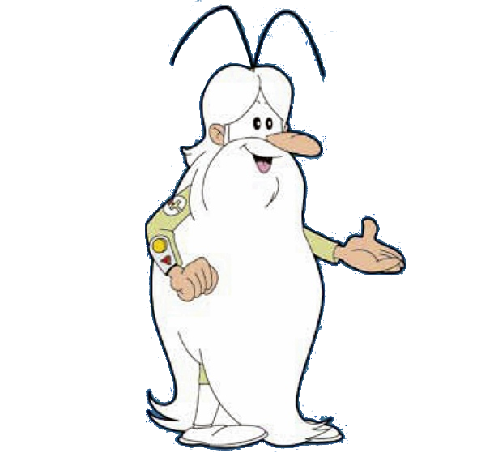
Once upon a time… Infrastructure automation
Desktop era |  |  |  |  | VMs era |  |  |  |  |  |  |  |  |  | Containers era
Early 2000s |  |  |  |  | Late 2000s |  |  |  |  | Early 2010s |  |  |  |  | Late 2010s |  |  |  | Early 2020s
 | 2002 | 2003 | 2004 | 2005 | 2006 | 2007 | 2008 | 2009 | 2010 | 2011 | 2012 | 2013 | 2014 | 2015 | 2016 | 2017 | 2018 | 2019 | 2020 | 2021 | 2022
Manual Deployments

Slide 12
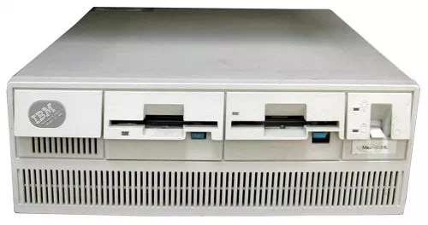
At the beginning…
Manual compilation and first package managers (rpm, apt-get)
First Web Applications: cgi-bin, servlets
Minimal dependencies (JRE + Tomcat, PHP)
Manual deployments (i.e. scp o FTP)
Several differences between servers

Slide 13
What can we automate?
Application Code
Database
Runtime
Web Server
Operating System
Hardware
Minimal Automation ☹

Slide 14
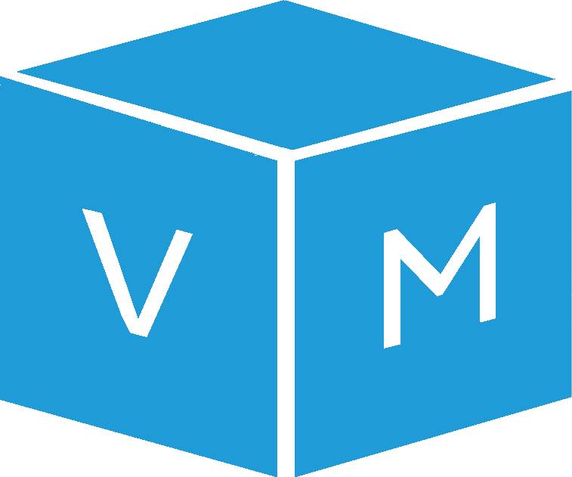
Once upon a time… Infrastructure automation
Desktop era |  |  |  |  | VMs era |  |  |  |  |  |  |  |  |  | Containers era
Early 2000s |  |  |  |  | Late 2000s |  |  |  |  | Early 2010s |  |  |  |  | Late 2010s |  |  |  | Early 2020s
 | 2002 | 2003 | 2004 | 2005 | 2006 | 2007 | 2008 | 2009 | 2010 | 2011 | 2012 | 2013 | 2014 | 2015 | 2016 | 2017 | 2018 | 2019 | 2020 | 2021 | 2022
Manual Deployments
Virtualization appears

Slide 15

At the beginning…
Dot-com bubble burst: need to consolidate and save cost
Automatic provisioning of bare metal servers
Example: Network Boot and Golden Images
Deploy!
Administrator
v2
Golden Image
Version control!

Slide 16
Emergency of virtualization
App. Code
App. Code
App. Code
VMs
Bin/Libs
Bin/Libs
Bin/Libs
Guest OS
Guest OS
Guest OS
Hypervisor Software (VMM)
Host Operating System
Hardware

Slide 17
What can we automate?
Application Code
Database
Runtime
Web Server
Operating System
Hardware
We gain reproducibility, but varies between companies
Still too soon for virtualization

Slide 18
Once upon a time… Infrastructure automation
Desktop era |  |  |  |  | VMs era |  |  |  |  |  |  |  |  |  | Containers era
Early 2000s |  |  |  |  | Late 2000s |  |  |  |  | Early 2010s |  |  |  |  | Late 2010s |  |  |  | Early 2020s
 | 2002 | 2003 | 2004 | 2005 | 2006 | 2007 | 2008 | 2009 | 2010 | 2011 | 2012 | 2013 | 2014 | 2015 | 2016 | 2017 | 2018 | 2019 | 2020 | 2021 | 2022
Manual Deployments
Virtualization appears
Configuration management

Slide 19
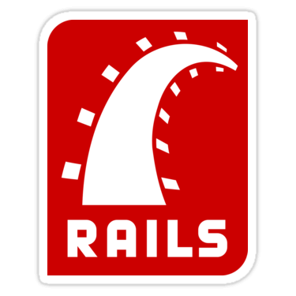


Modern Application Development
Web 2.0: Ruby on Rails, NodeJS, Django
Virtualization becomes widespread in Enterprise environments
Cloud Computing arrives!

Slide 20
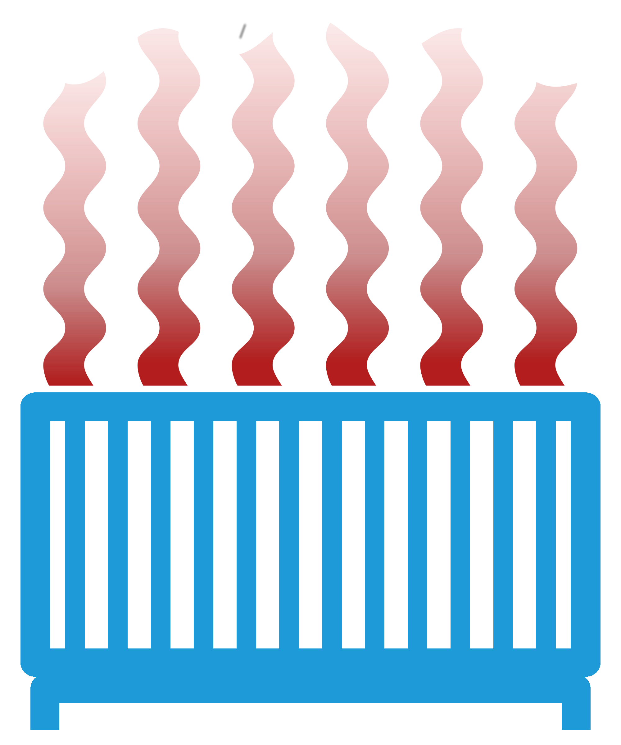


Cloud Computing?
“Computing may someday be organized as a public utility just as the telephone system is a public utility,”
Professor John McCarthy, 1961
?

Slide 21
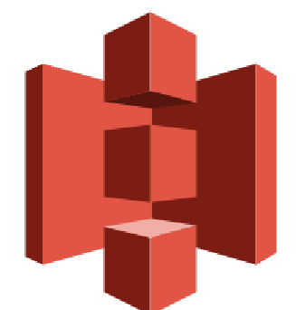



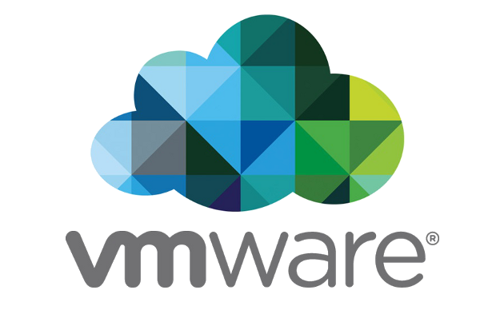
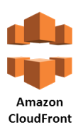


The Cloud Platform (Typical setup)
Virtual
resources
No upfront costs
On demand access
Pay-as-you-go approach
Full catalog of services
Bare metal
resources
S3
RDS
CloudFront
Route 53

Slide 22
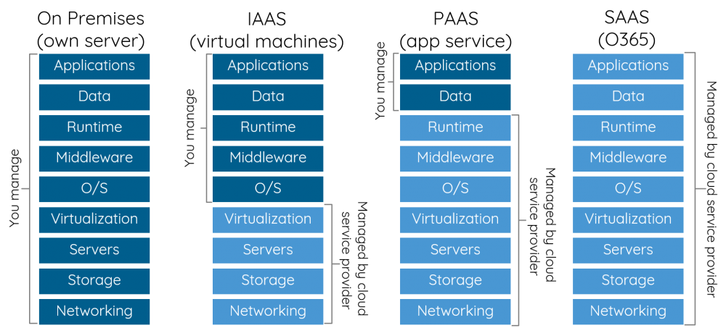
Everything as a service

Slide 23
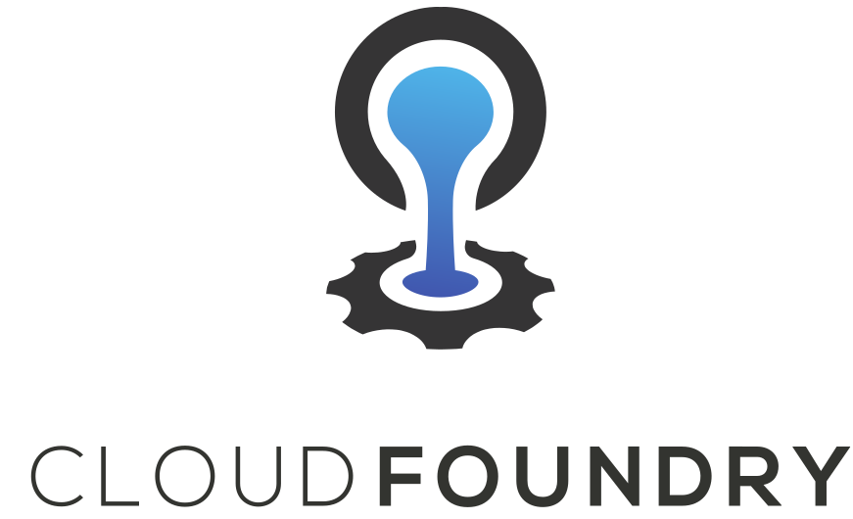
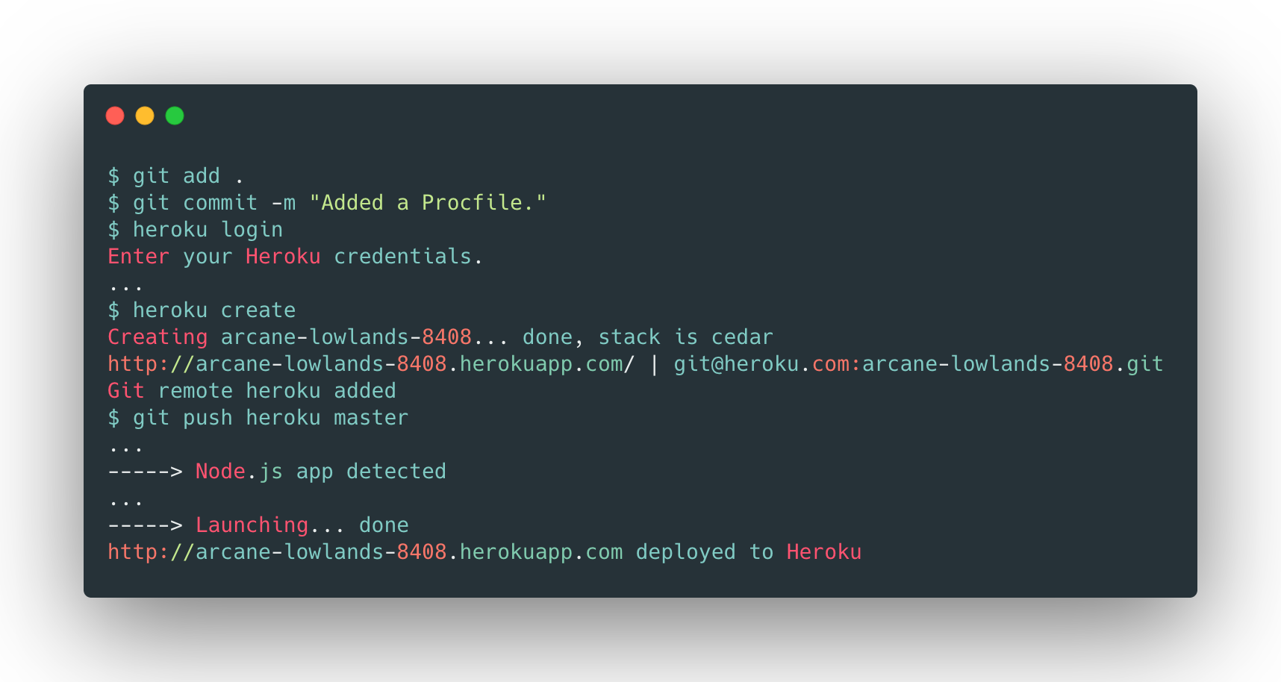

New tools
PaaS

Slide 24
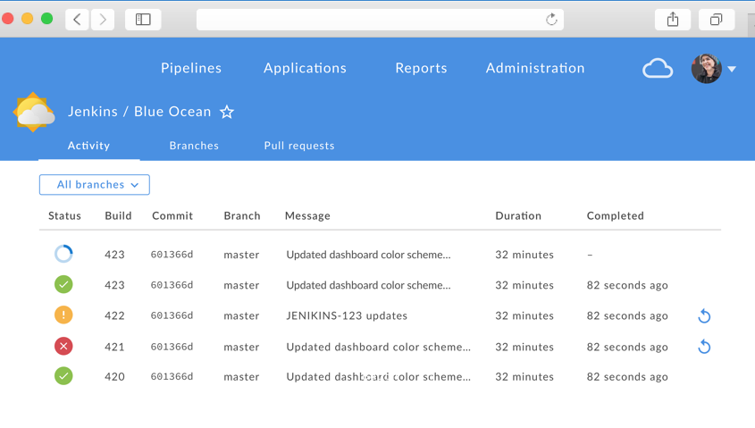

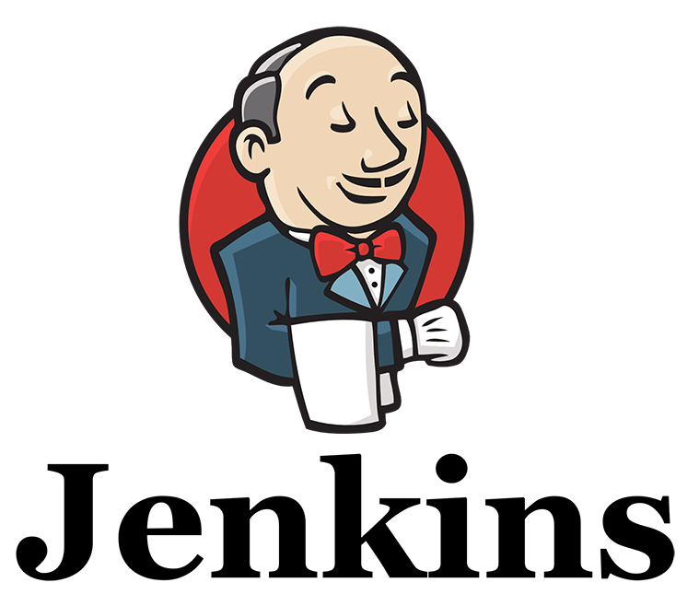
New tools
Continous Integration
Code
Commit
Test
Stage
Deploy
Build

Slide 25

Beginning of a new paradigm
12-factor apps (https://12factor.net/)
Methodology for building software-as-a-service apps
Factor 1:
One codebase tracked in revision control, many deploys
Factor 2:
Explicitly declare and isolate dependencies
Factor 3:
Store config in the environment
Factor 5:
Strictly separate build and run stages
Factor 6:
Execute the app as one or more stateless processes

Slide 26
What can we automate?
Application Code
Database
Runtime
Web Server
Operating System
Hardware
New paradigm that boosts productivity and ease of management
Applications and companies not ready yet

Slide 27
What can we automate?
Application Code
Database
Runtime
Web Server
Using PaaS
Operating System
Hardware
Runtimes are limited

Slide 28
Once upon a time… Infrastructure automation
Desktop era |  |  |  |  | VMs era |  |  |  |  |  |  |  |  |  | Containers era
Early 2000s |  |  |  |  | Late 2000s |  |  |  |  | Early 2010s |  |  |  |  | Late 2010s |  |  |  | Early 2020s
 | 2002 | 2003 | 2004 | 2005 | 2006 | 2007 | 2008 | 2009 | 2010 | 2011 | 2012 | 2013 | 2014 | 2015 | 2016 | 2017 | 2018 | 2019 | 2020 | 2021 | 2022
Manual Deployments
Virtualization appears
Configuration management
Cloud Native apps

Slide 29
The Cloud Computing era
Massive adoption of Infrastructure as a Service (IaaS)
Stacks become more complex: NoSQL, Microservices
End to end automation, including infrastructure
There are API calls for virtually everything

Slide 30
Cloud Native applications
Official definition (https://github.com/cncf/toc/blob/master/DEFINITION.md)
“Cloud native technologies empower organizations to build and run scalable applications in modern, dynamic environments such as public, private, and hybrid clouds. Containers, service meshes, microservices, immutable infrastructure, and declarative APIs exemplify this approach.
These techniques enable loosely coupled systems that are resilient, manageable, and observable. Combined with robust automation, they allow engineers to make high-impact changes frequently and predictably with minimal toil.”
?

Slide 31
Cloud Native applications
Lift and shift
Cloud Native
Initially not targeted
to the cloud
Application
Application
Migrated to the Cloud
Application
From the beginning
targeted to the cloud

Slide 32

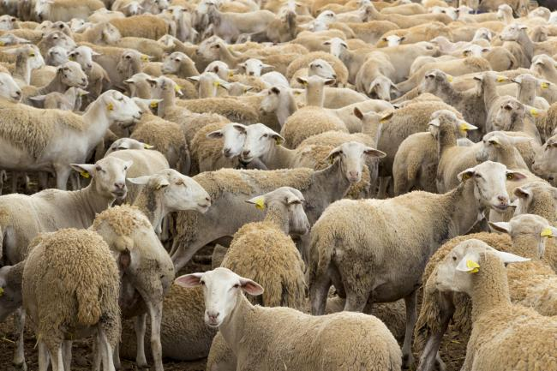
Further in the paradigm: Pets vs Cattle
Pets:
Treated as unique
Typically manually built, managed and updated.
Indispensable, can’t be down
Cattle:
Treated as “just one more”
Automatically built
Designed for failure
Interesting read: The History of Pets vs Cattle and How to Use the Analogy Properly

Slide 33
Immutability?
If we separate state from code (factor 6), then we can change the way to deploy. Example:
Before
Code
Commit
Test
Stage
Deploy
Build
Step 3
Step 2
Application Code
Database
Application Code
Runtime
Server
Step 1
Operating System

Slide 34
Immutability?
Factor 9:
Maximize robustness with fast startup and graceful shutdown
Factor 10:
Keep development, staging, and production as similar as possible
Alternative
Code
Commit
Test
Stage
Deploy
Build
Step 1
Application Code
Application Code
Database
Runtime
Server
Runtime
Server
Same
Operating System
Operating System
Immutable VM
Immutable VM

Slide 35
Question
Do we really care about having a whole virtual Operating System and its virtual hardware?
Application Code
Application Code
Runtime
Server
Runtime
Server
Operating System
Immutable VM
Container

Slide 36
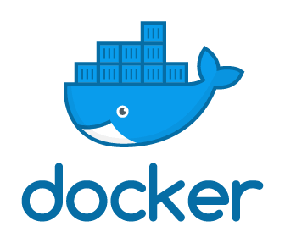

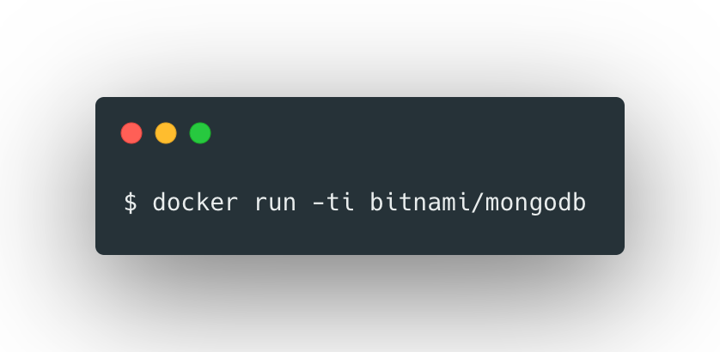

Hello to containers!
Container: standard unit of software that packages up code and all its dependencies (and nothing else)
Possible thanks to Linux Kernel enhancements (example: cgroups)
Properties
Runtimes / Engines
Lightweight
Consistent
Easy adoption

Slide 37
Containers in Production?
Load Balancing
Zero downtime
Rolling Updates
Dynamic scalability
Automatic deployments
Role-Based Access Control
Easy migration
Monitoring
Failover mechanisms
Solution: Container orchestration

Slide 38
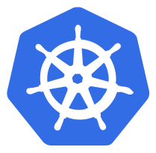
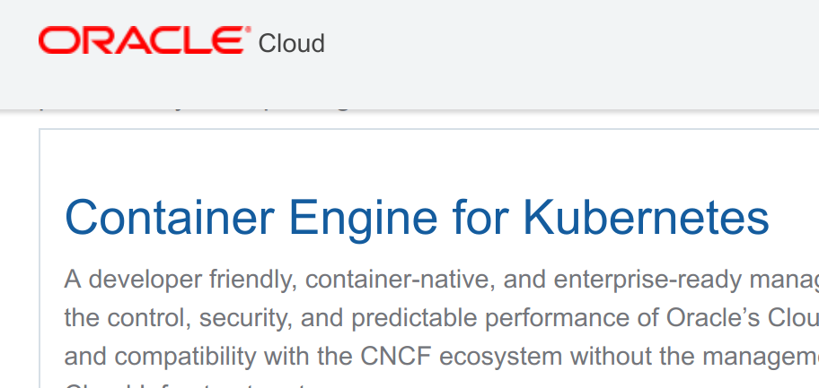
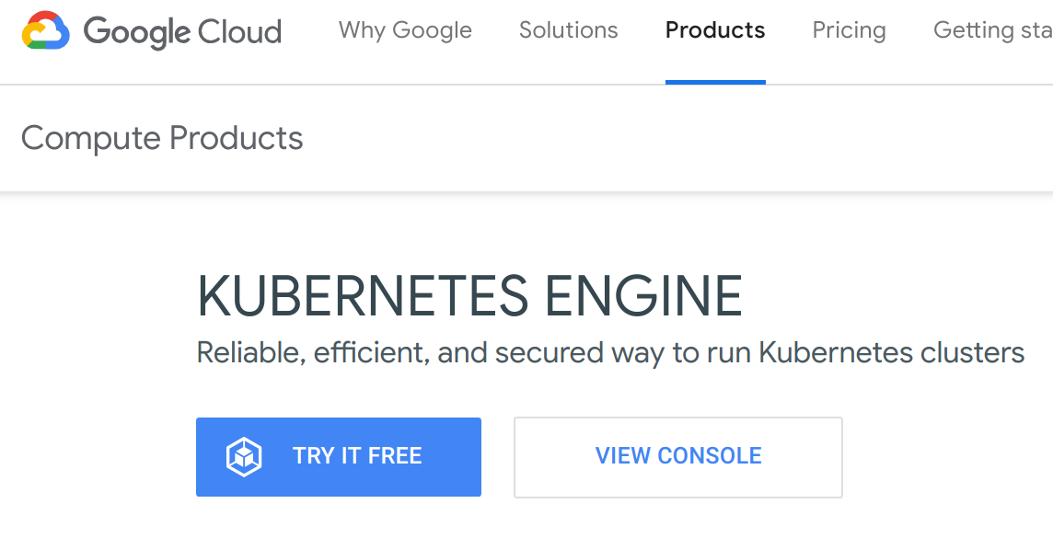
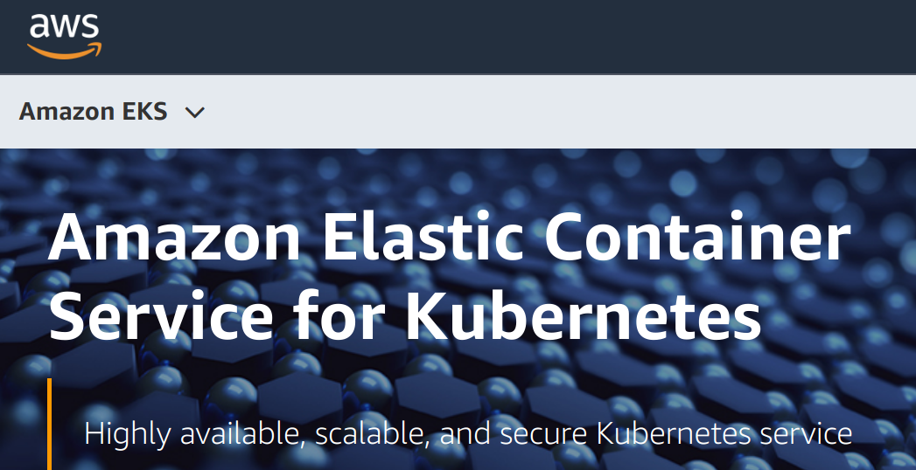
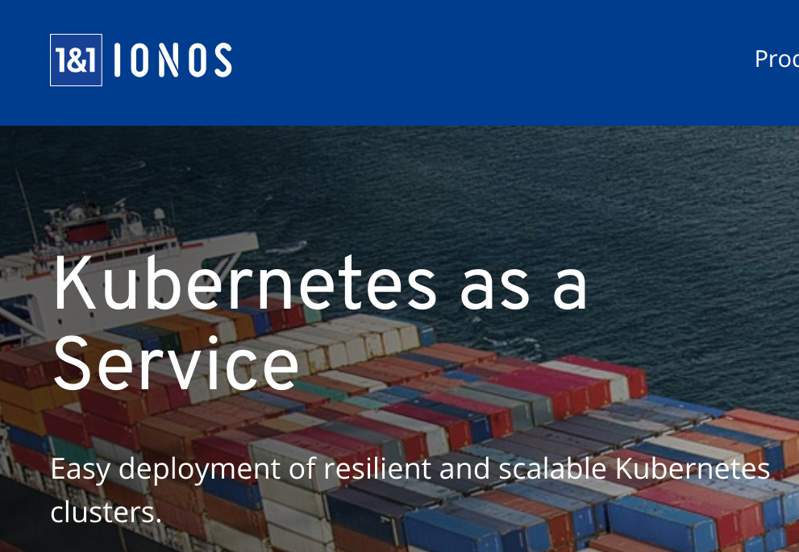
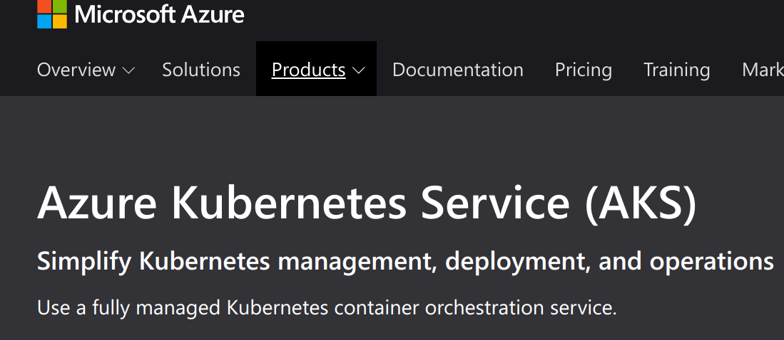
Kubernetes: Containers in Production
Builds on 15 years of experience at Google
No need to focus on server lifecycle
“Universal” PaaS

Slide 39






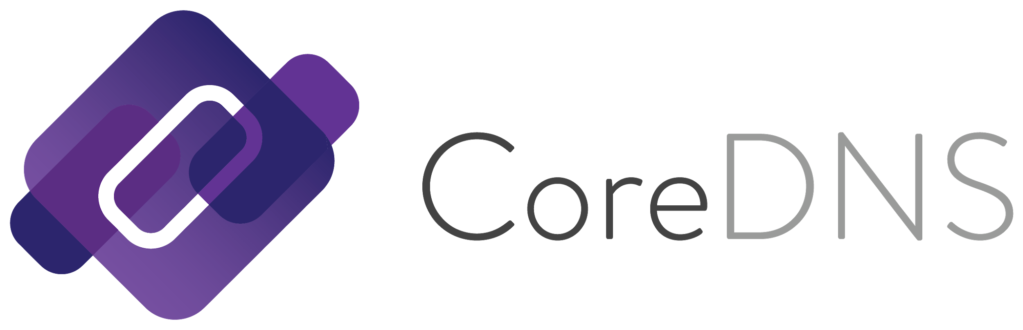

Kubernetes: Center of the Cloud-Native ecosystem

Slide 40

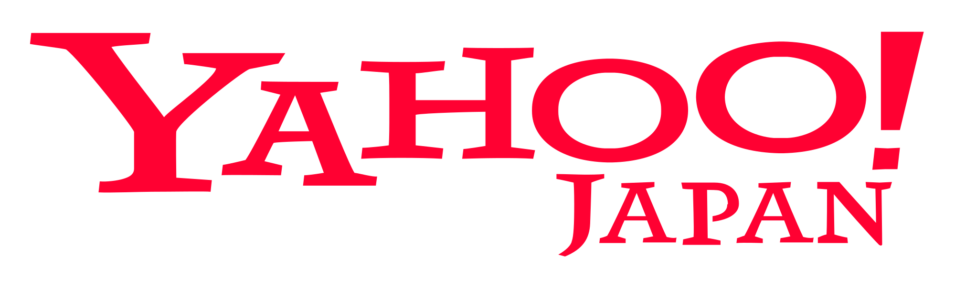

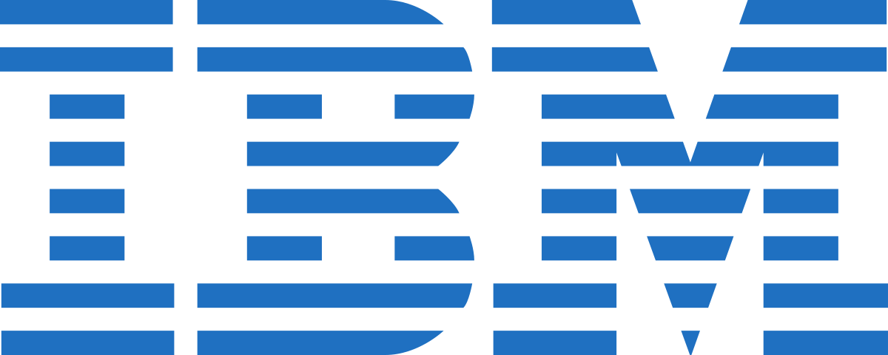

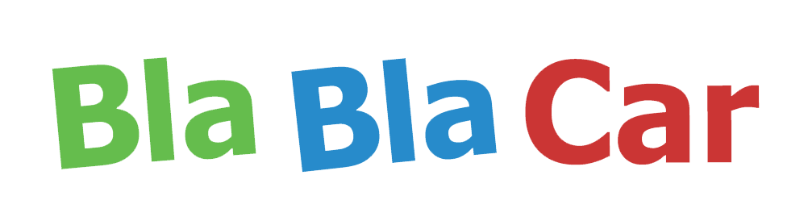


Kubernetes: Used in several projects
and more...

Slide 41
So now…
Application Code
Database
Runtime
Web Server
Operating System
Hardware
Automation is not optional

Slide 42
Extra: Serverless, the future?
Up until now, we have talked about servers: either in the form of VMs or containers
Application Code
????
Runtime
Server
Operating System
Server
less

Slide 43
What’s really happening?
f2
f4
Application Code
f1
f3
f5
f1
f2
f3
f4
f5
Under the hood (example)
We deploy functions to the cloud
Functions can interact with each other
We have events and triggers
Examples: AWS Lambda, Google Functions...
Function f5 Code
Runtime
Server
So there’s a server!!

Slide 44
This is where we are right now
Desktop era |  |  |  |  | VMs era |  |  |  |  |  |  |  |  |  | Containers era
Early 2000s |  |  |  |  | Late 2000s |  |  |  |  | Early 2010s |  |  |  |  | Late 2010s |  |  |  | Early 2020s
 | 2002 | 2003 | 2004 | 2005 | 2006 | 2007 | 2008 | 2009 | 2010 | 2011 | 2012 | 2013 | 2014 | 2015 | 2016 | 2017 | 2018 | 2019 | 2020 | 2021 | 2022
Manual Deployments
Virtualization appears
Configuration management
Cloud Native apps

Slide 45
Preparing our environment: Git
Jota - jotamartos@vmware.com

Slide 46
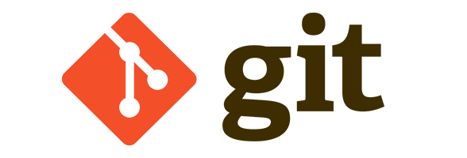
Git Introduction
Git is a distributed revision control and source code management system with an emphasis on speed, data integrity, and support for distributed, non-linear workflows.
Central revision control: CVS, Subversion
Distributed: Bazaar, Mercurial (Hg), Darcs and more
Public repositories: GitHub, BitBucket, ...
Private repositories: GitHub, Gitolite, GitLab, Gitorious,...
It uses SSH, it is necessary to configure your private/public key
It is also possible to use HTTP/HTTPS

Slide 47
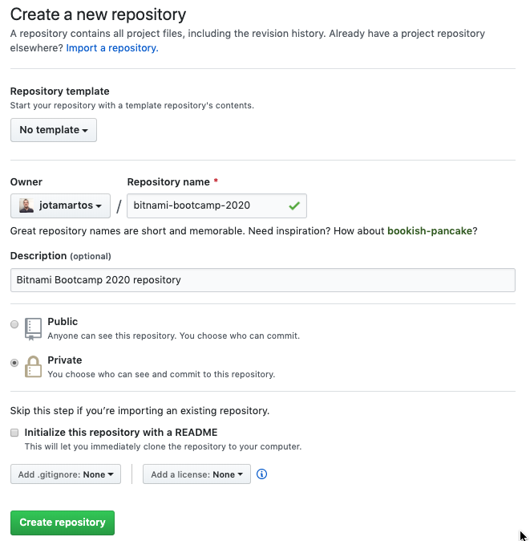
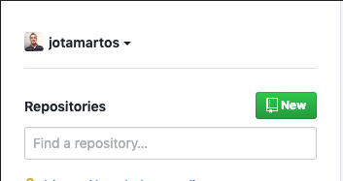
Create a GitHub repository

Slide 48
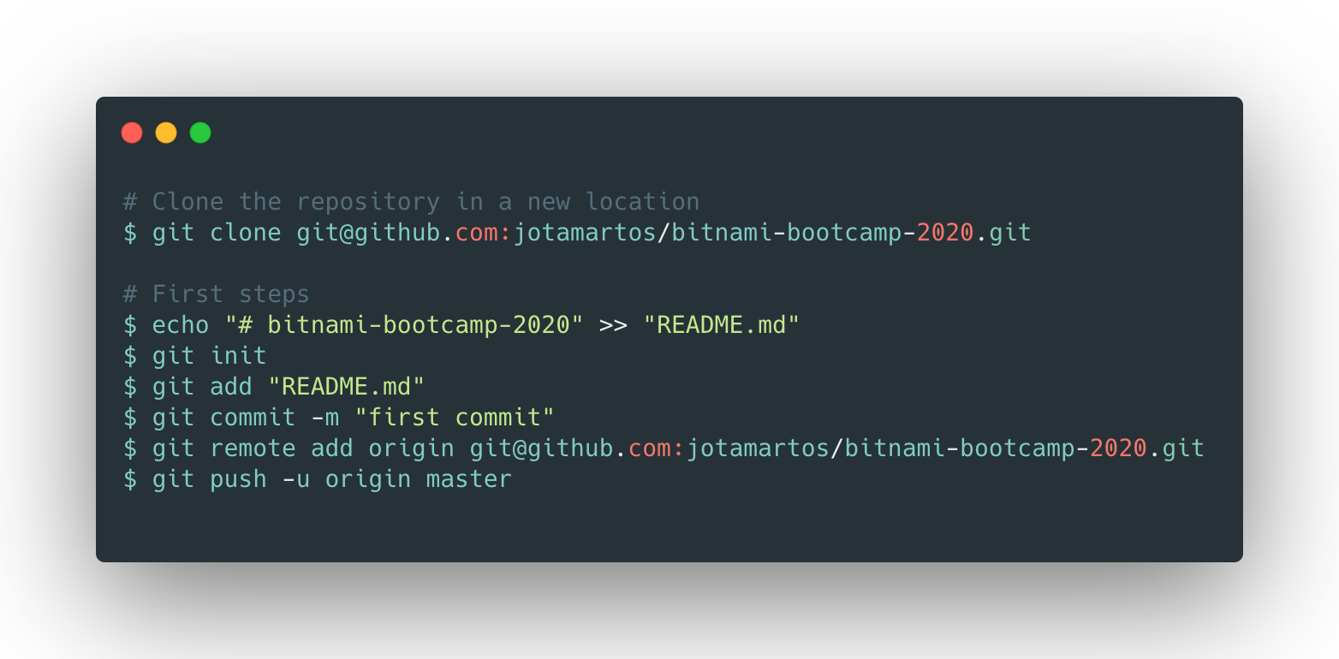
Create a GitHub repository

Slide 49
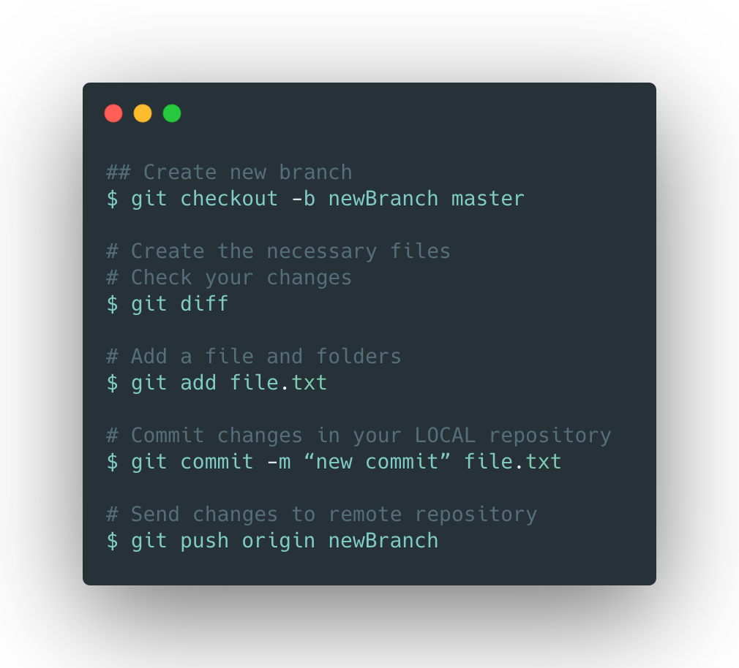
Create a GitHub repository

Slide 50
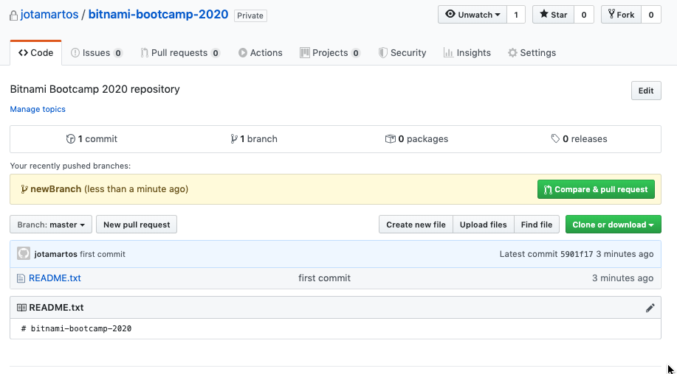
Create the PR

Slide 51
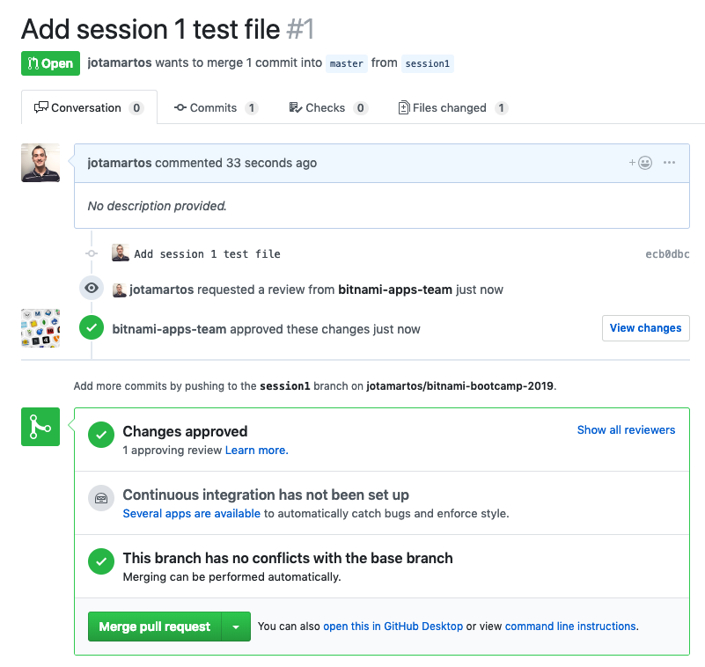
Merge PR

Slide 52
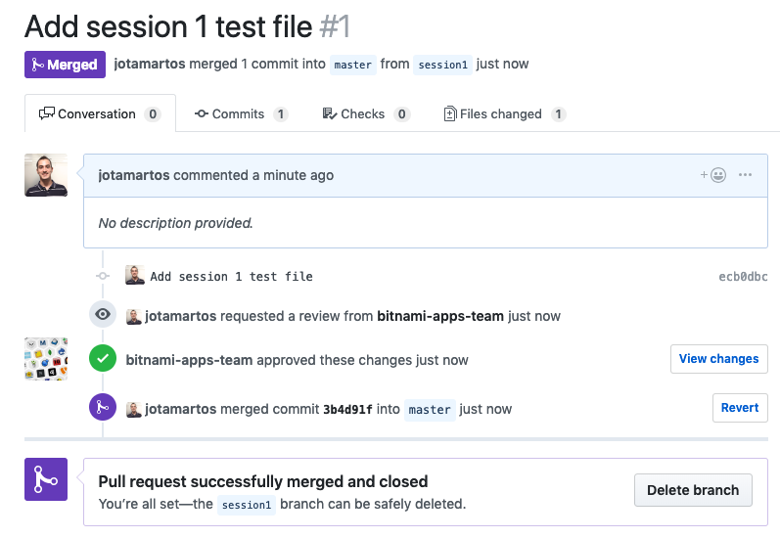
Merge PR

Slide 53
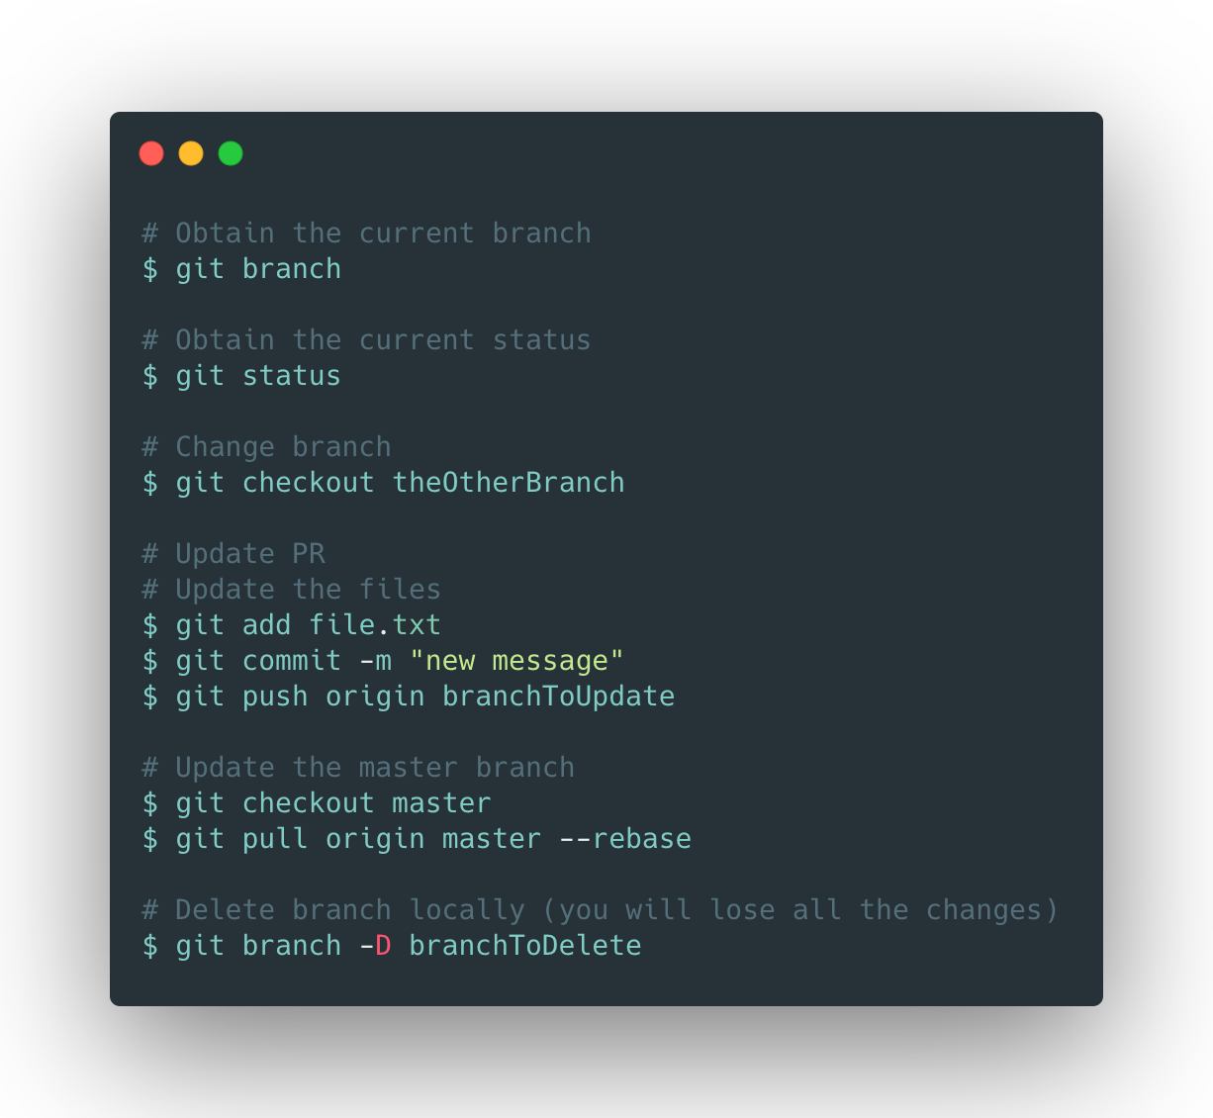
Useful commands

Slide 54
Introduction to Docker
Salme - jsalmeron@vmware.com

Slide 55
What is Docker?
Engine for running containers written in Go
Released in 2014
Licensed under the Apache 2.0 license
Open Source
Increasing adoption: 20% of all hosts use Docker

Slide 56
The Docker Engine
Allows communication between containers
Allows persistence in containers
Networking
Volume
Push and pull image registries
Docker CLI
Docker API
Distribution
containerd
BuildKit
Runs containers
Creates container images

Slide 57
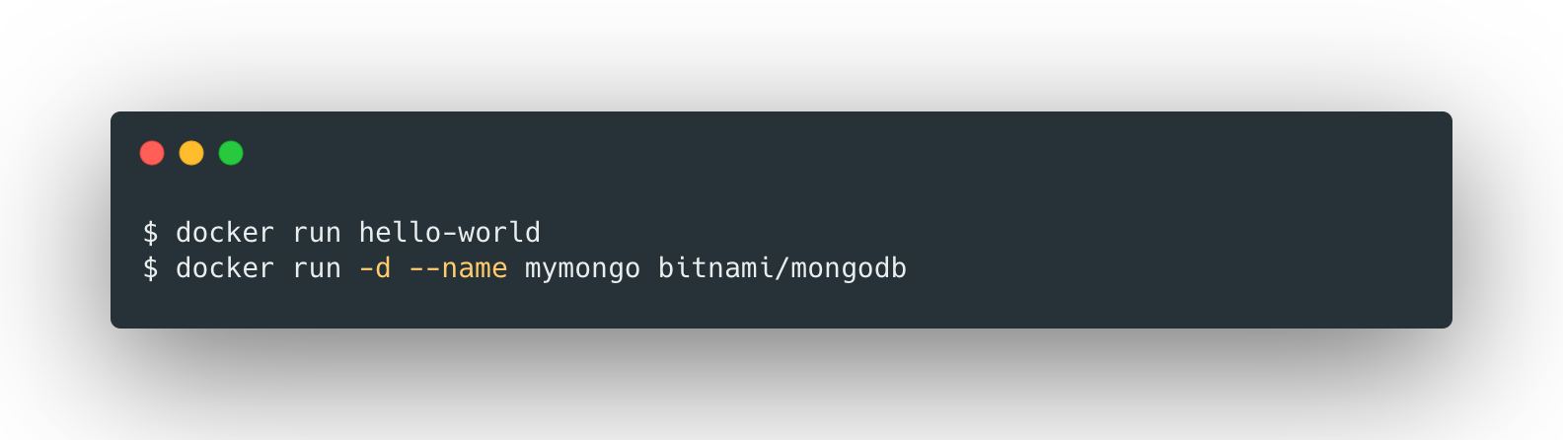
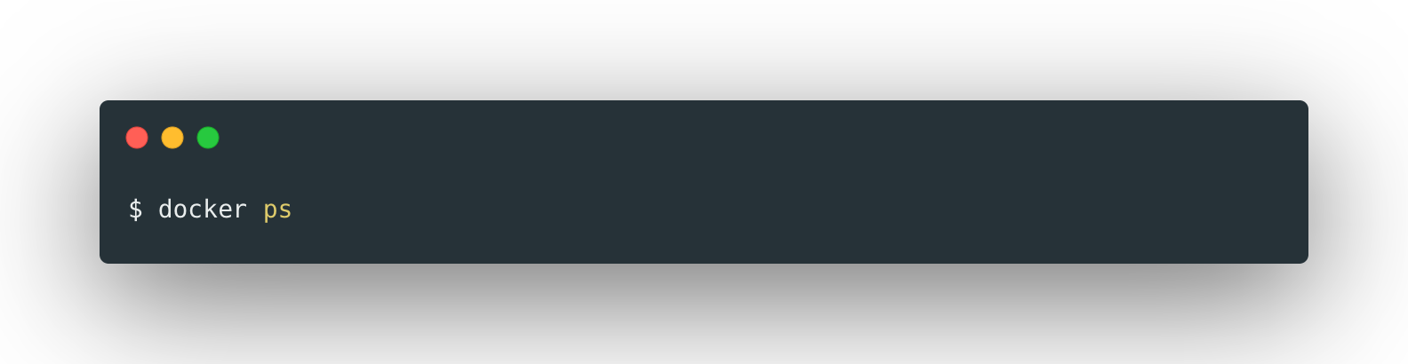
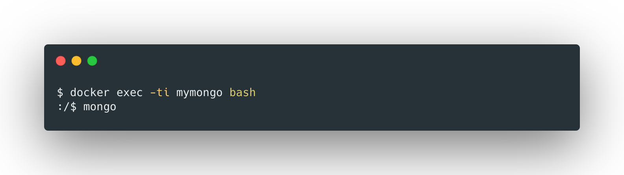
Let’s start playing with the client
Install the client: https://docs.docker.com/install/
Let’s run some containers
Check running containers
Enter running container

Slide 58
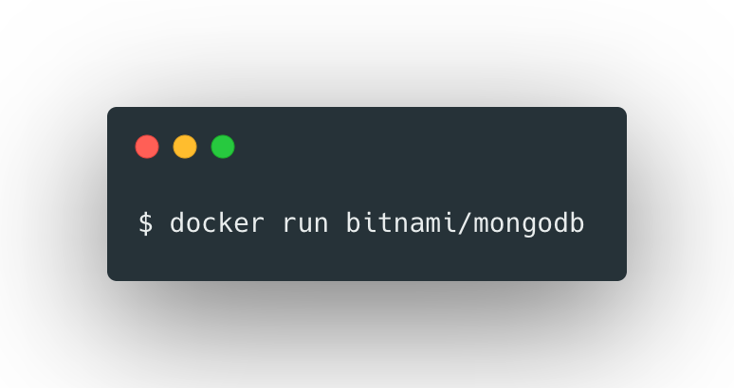
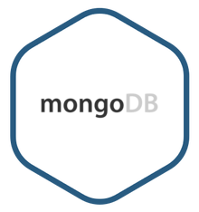
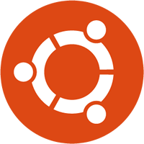

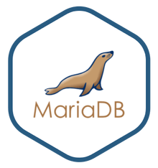
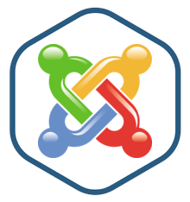

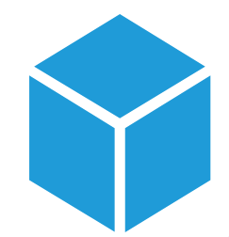
Replay
Docker Daemon
Docker Client
Distribution
Docker Hub Registry
1
Docker API
2
1 - Pull image from registry
containerd
2 - Create container from image

Slide 59
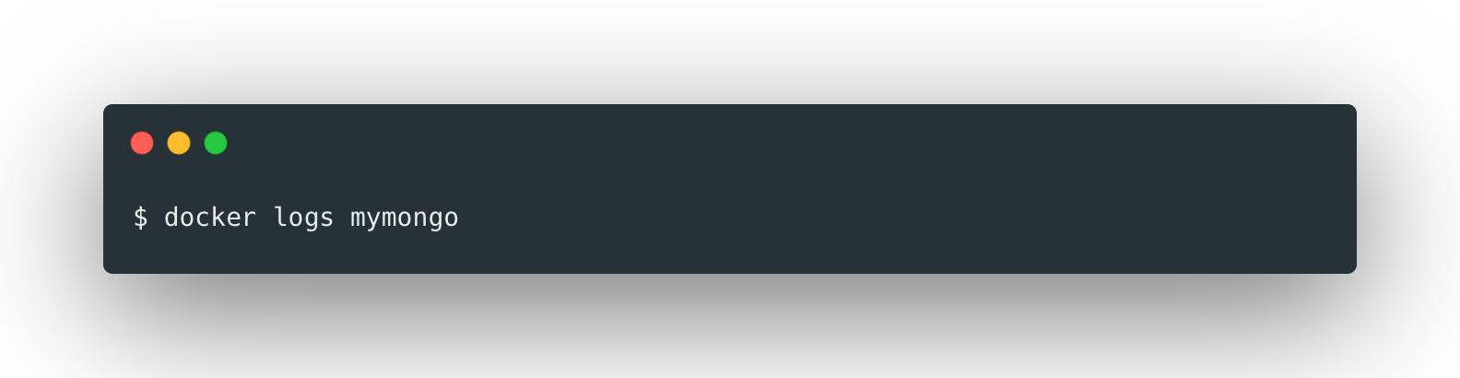




More client commands
Check container logs
Inspect container data
Check container running processes
Check container resource consumption
Pause a running container

Slide 60

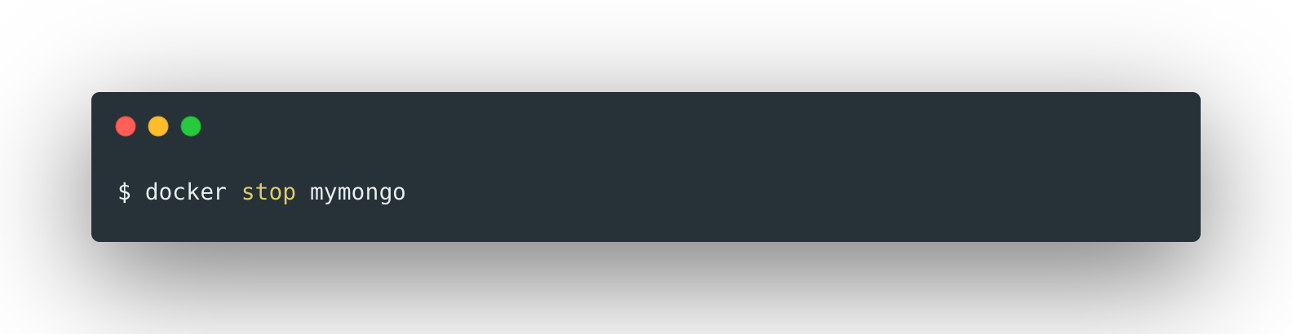



And more client commands!
Unpause running container
Stop running container
Start running container
Kill running container
Delete running container

Slide 61
A bit about images
An image is a collection of files. Read-only template.
Built up from a series of layers
Each layer represents a diff from the previous layer
Last layer is writable
Possible thanks to the union filesystem OverlayFS
Image identifier
bitnami/minideb
docker.io/bitnami/minideb:latest
REPOSITORY[:TAG]
registry.rhc4tp.openshift.com/bitnami/rhel-extras-7:7-r264

Slide 62
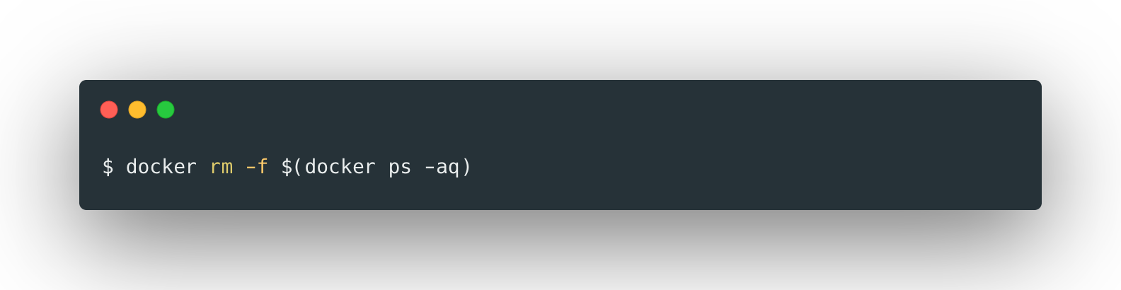
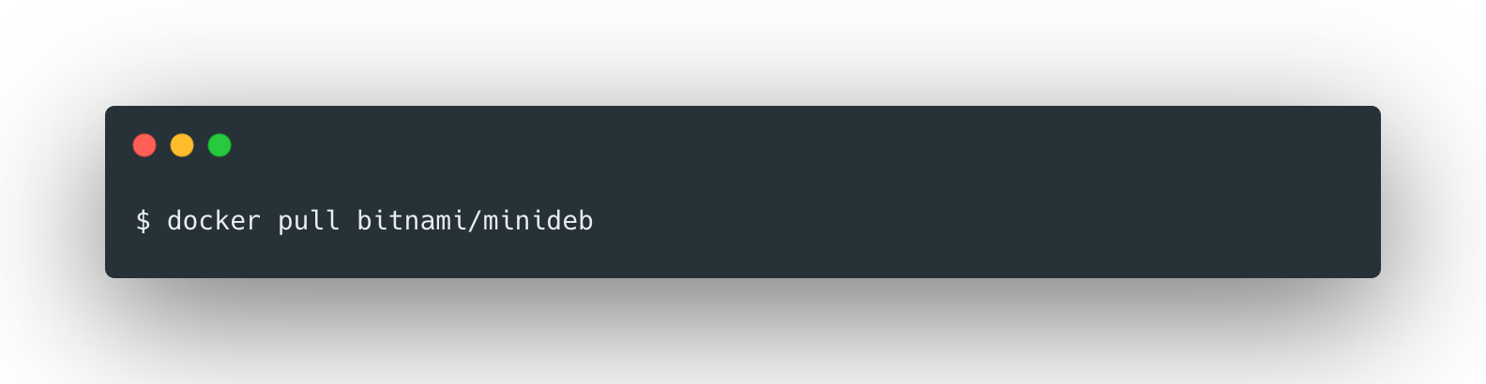
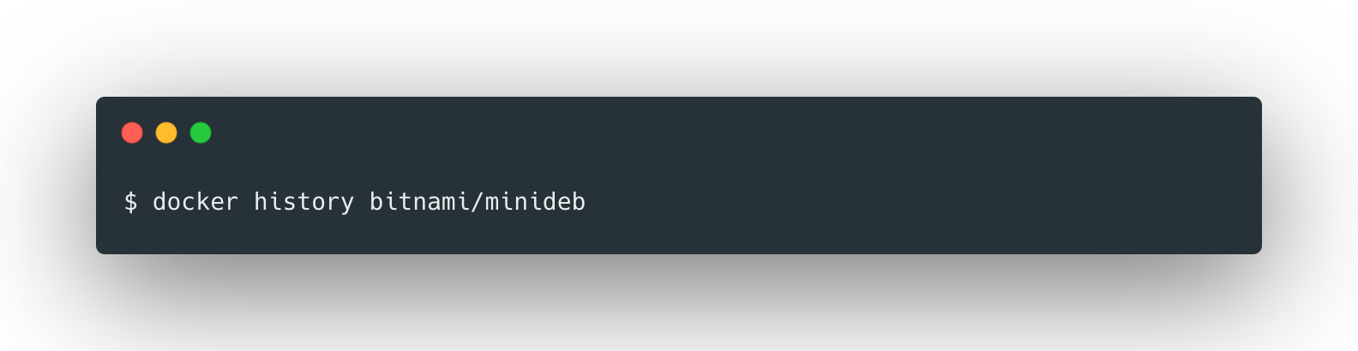

Let’s explore a bit the filesystem
Force remove all containers
Make sure we do not have any container running
Get the Bitnami Minideb
Check the layers that the image has
Launch a Bitnami Minideb container and attach to it
attach
command

Slide 63



Let’s explore a bit the filesystem (II)
Create a file inside the container
Delete a file inside the container
Now we have a diff, let’s check it!
Easy way:

Slide 64

Let’s explore a bit the filesystem (III)
Let’s get powerful and get the mountpoints that OveralyFS is using
Explore these folders, what do you see?

Slide 65



Let’s explore a bit the filesystem (IV)
Finally, let’s create a new image
Check the history of the new image
We can export the image if we want
Let’s explore it with an archive manager!

Slide 66


Image registry
Repository where docker images are stored
Docker daemon has one local in the machine
Docker Hub: Most commonly used registry
Accessible using the CLI
Question: what does “official” mean?

Slide 67

Configuring our containers
We need a way to add configuration to our containers
Factor 3:
Store config in the environment
Containers would normally allow passing configuration parameters in the form of environment variables
Example: check Bitnami MariaDB container documentation
Let’s launch a container that creates a database with given credentials
Enter the container and execute env. What do you see?

Slide 68
About networking
We have a MariaDB container, but what if we want another container to access it?
Docker default network driver: bridged
Ephemeral IP
172.19.0.2
172.17.0.2
172.17.0.3
172.18.0.2
172.18.0.3
name: test
name: mymaria
name: client
name: maria2
name: wp
Container network
NETWORK: TEST
NETWORK: DEFAULT
NETWORK: WORDPRESS
Host
network
Can create multiple subnetworks
Bare metal host
192.168.10.2

Slide 69





Let’s connect containers
Deploy a mysql client
Try accessing
Let’s use networks now!
Inspect the newly create network
Deploy MariaDB in this new network (do the same with the client)

Slide 70
Question
We accessed MariaDB using a client
NETWORK: DEFAULT
But INSIDE the container network
172.17.0.2
172.17.0.3
Can we access from the HOST NETWORK?
Port 3306
Solution: Port binding (or publishing)
Container network
Host
network
We make one container port available in the host
Port 3306
192.168.10.2

Slide 71

Port publishing
Can we publish the port of an already created container? No
So we need to remove it and start a new one
Port 3306
Port 3306
Alternatives
Try now!
-p 3306
Container port 3306 → Random available port in host
-P
All exposed container ports → Random available ports in host
???
Images expose ports
→ ????? → Session 2

Slide 72
What happened to the data?
MariaDB is a stateful application
Data lost!
Stateful applications require persistent data
Containers are ephemeral
Volume
Solution: use volumes to provide persistent storage
Data safe!

Slide 73


Working with volumes
Docker has a volume component that manages storage
Let’s inspect it
There are different drivers for volume

Slide 74



First test!
Can we mount a volume in a running container? No
Let’s create a container that mounts the volume
Volume Name : Mount Point
Can a volume be used by multiple containers? Yes*
Now let’s delete the containers and create a new one
* Depends on the driver

Slide 75



Let’s go back to MariaDB!
Now let’s create a MariaDB database with persistence
Delete the old container
Create a new volume
Deploy the new container with the volume
Where do we mount it inside the container?

Slide 76


Check each container documentation!
The container developer should specify how to deal with persistence

Slide 77

Alternative to volumes: specify host paths
Instead of creating volumes, you can directly specify a path in your host
This can be useful for development, but generally problematic

Slide 78




Tips for not running out of space!
When working with Docker, you may run out of disk space
Command to delete all stopped containers
Command to delete all unused images
Command to delete all unused volumes
Destroy everything unused!

Slide 79
Introduction to Docker Compose
Salme - jsalmeron@vmware.com

Slide 80
Question
We learnt to create more complex deployments
The number and length of commands increase as well
Is there an easier alternative than using CLI commands?
Can we create container groups as if they were projects?

Slide 81

Solution: Docker Compose
Tool automate multi-container configuration using declarative files
Define a multi-container application in a single YAML file, then spin up in a single command
Easy installation

Slide 82

Docker Compose yaml file
Everything is defined in a docker-compose.yml file
Basic structure

Slide 83





Previous examples with Compose
Example: Simple MongoDB instance
It’s better not forcing a container name and let Compose create one
Deploy with one command
Teardown with one command

Slide 84




Previous examples with Compose
Example: MariaDB instance (with env vars, no persistence)

Slide 85


Previous examples with Compose
Example: MariaDB instance (with env vars, ports, no persistence)

Slide 86



Previous examples with Compose
Example: MariaDB instance & client
Not necessary, Docker Compose already creates a network
Interactive commands make no sense in this context
This enforces deployment order

Slide 87





Previous examples with Compose
Example: MariaDB instance & client
Check the containers statuses
Stop one container
Launch one with a different command
Launch one without dependencies
Check logs

Slide 88






Previous examples with Compose
Example: MariaDB with persistence
To delete volumes:

Slide 89
Exercises

Slide 90
Exercises
Using Docker CLI
Exercise 1: Find the way to launch a container that auto-restarts on failure
Exercise 2: Find the way to launch a container that auto-deletes itself when finished
Exercise 3: Find the way to set the number of CPUs a container can use
Exercise 4: Find the way to create a privileged container. Try finding an operation that can be done using a privileged container and not a regular container
Exercise 5: Using docker ps, docker inspect and a bit of scripting to create a script that shows the container names together with its internal IP

Slide 91

Exercises
Using Docker
Exercise 6: Create a new image based on minideb that has the application kong. Use docker commit (we will see a different way next session)
Exercise 7: Create an account in Docker Hub and find the way to push an image (use the one in Exercise 6 for example)
Exercise 8: Find the way to “rename” an existing image (do not use commit). Example output

Slide 92
Deliverables
Exercise 9: Create two docker-compose projects
WordPress + MariaDB: Use bitnami/wordpress and bitnami/mariadb. It should have:
Persistence with volumes
Isolated in a network
Database Backup: This project is for running a mysqldump in the “WordPress + MariaDB” database. When executing docker-compose up, it should create a backup of the WordPress database and store it in a host path folder.

Slide 93

Deliverables
Exercise 10: Access different containers using domain name
I want to have two running installations: one with WordPress and another with Joomla (bitnami/wordpress, bitnami/joomla and bitnami/mariadb). I want to be able to access one or the other just by using domain names.
Edit your /etc/hosts file and add two entries
Create the docker-compose projects of both installations, and find a way (highly likely, a proxy container. Search the net!) that makes it possible
Notes:
Joomla and WordPress must be in different networks
Only one MariaDB instance

Slide 94
Thank You

